Slide 1
Web Traffic Time Series Forecasting

Slide 2
Project Overview
This project focuses on forecasting web traffic using time series analysis.
Web Traffic Time Series Forecasting involves analyzing historical patterns of user interactions on a website to predict future traffic trends.
As websites experience varying levels of activity, understanding and forecasting web traffic can be crucial for optimizing resource allocation, enhancing user experience, and making informed decisions.
We used Wikipedia page views dataset proposed in a competition by Kaggle in 2017 for training and testing the model for accuracy.

Slide 3
Exploratory Data Analysis
Dataset Overview:
Contains 145,063 rows and 551 columns.
Handling Missing Values:
Approximately 20,000 missing values across 10 columns, affecting around 14% of rows.
Opting for interpolation over median or average filling for a more refined approach, particularly effective for time series data.
Outlier Detection:
Identified outliers in 97,252 pages, highlighting the need for careful analysis and potential adjustment.

Slide 4
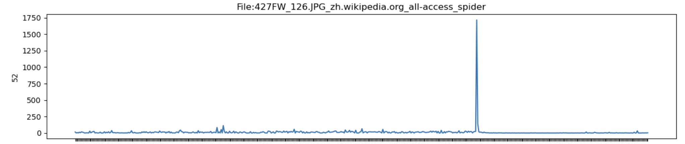
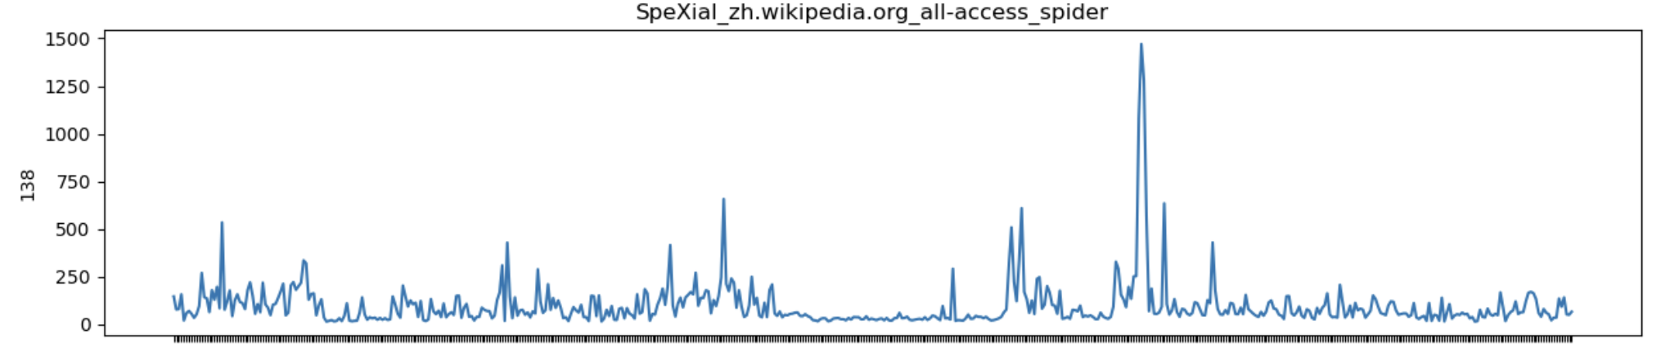
Exploratory Data Analysis: Outliers

Slide 5
Exploratory Data Analysis: Outliers
Detected outliers in 97,252 pages (67%)
Implemented capping strategy for outliers rather than removal.
Values below the lower bound adjusted to the lower bound.
Values above the upper bound adjusted to the upper bound.

Slide 6
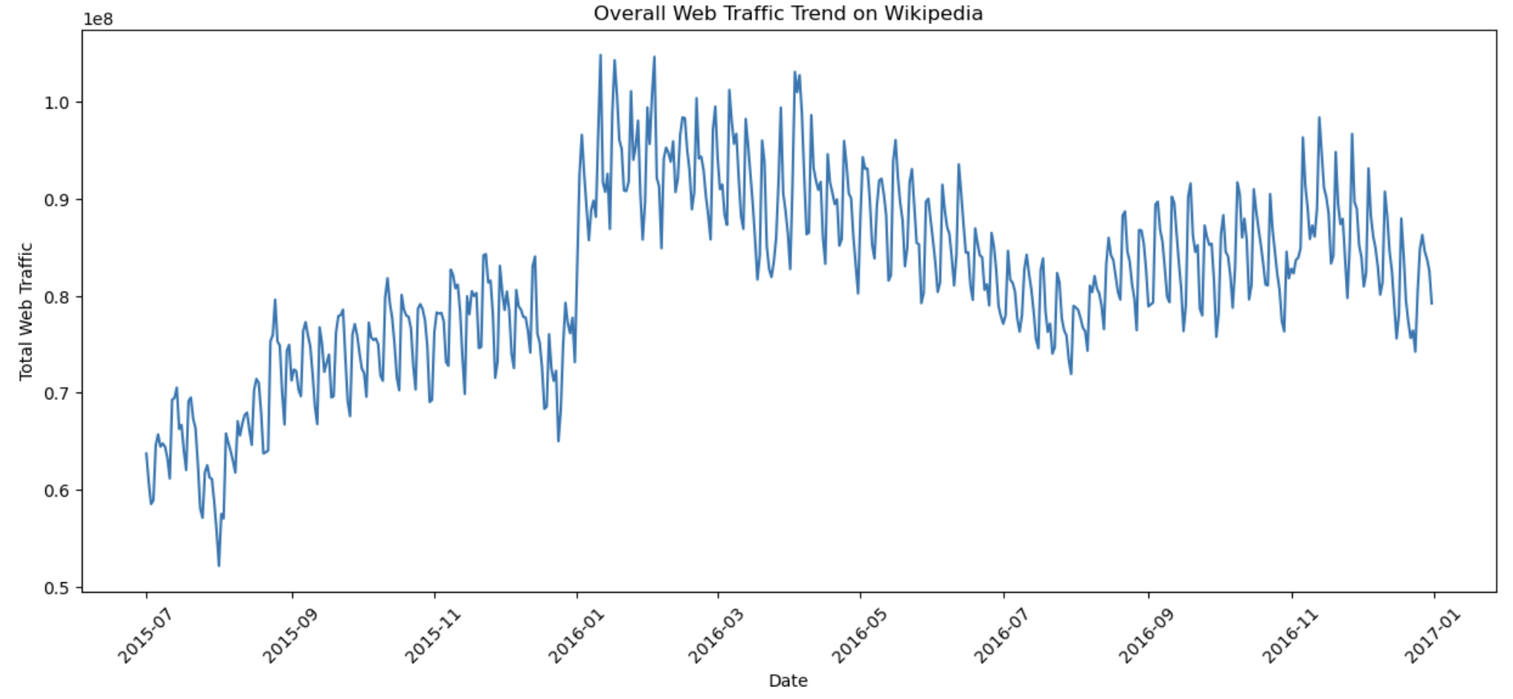
Exploratory Data Analysis: Overall Trends

Slide 7
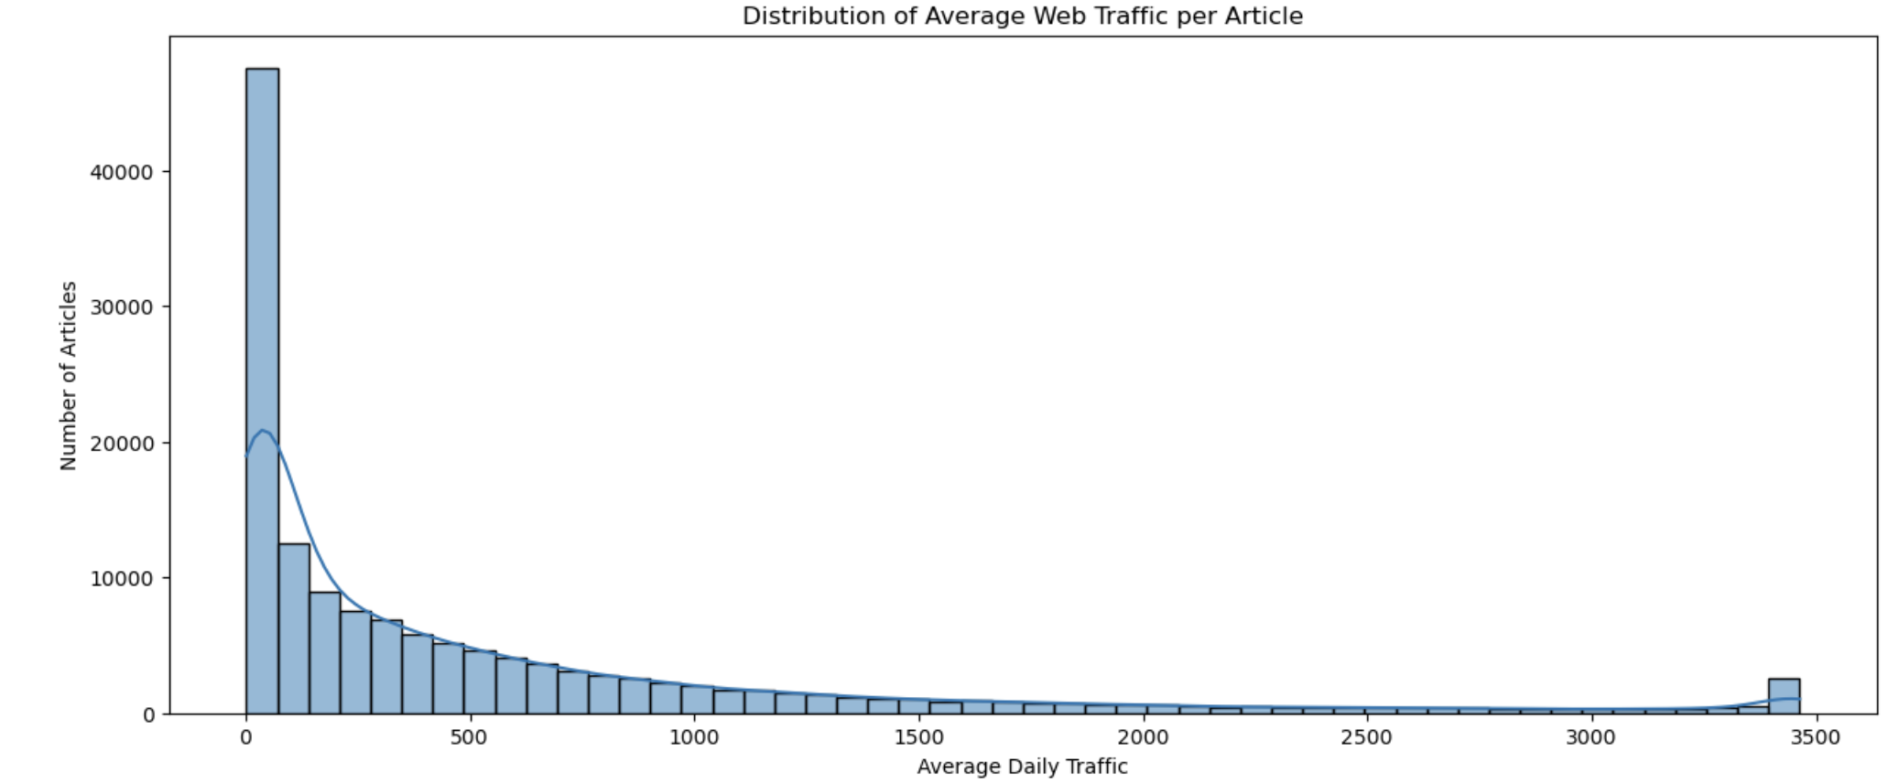
Exploratory Data Analysis: Distribution of Average Web Traffic per Article

Slide 8
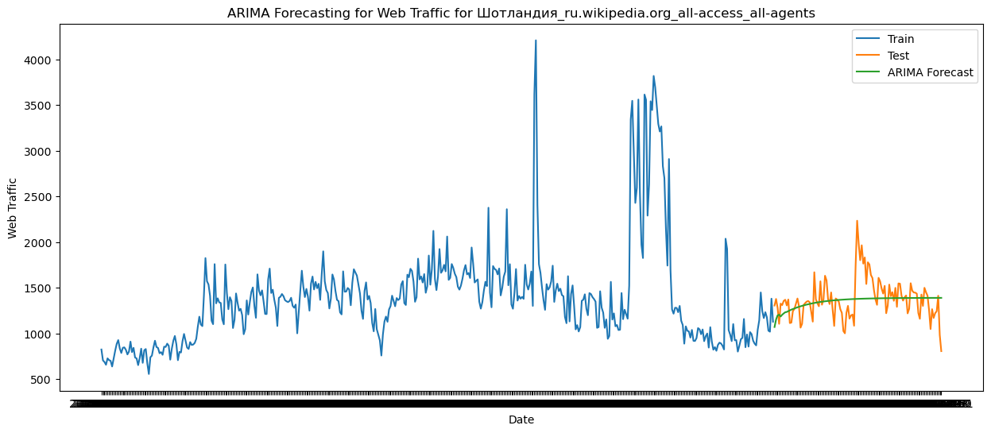
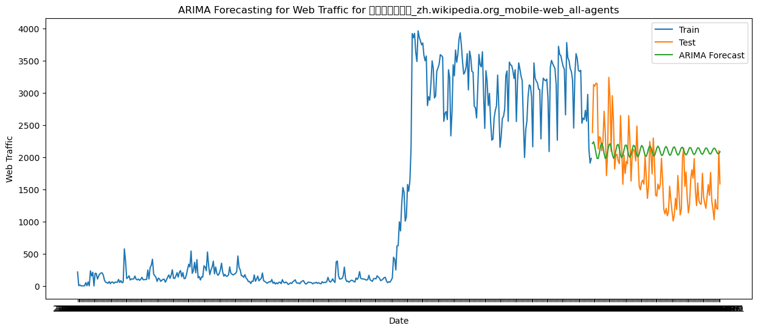
ARIMA Model Results
We have randomly sampled 5 webpages and ran ARIMA and observed the following results.

Slide 9
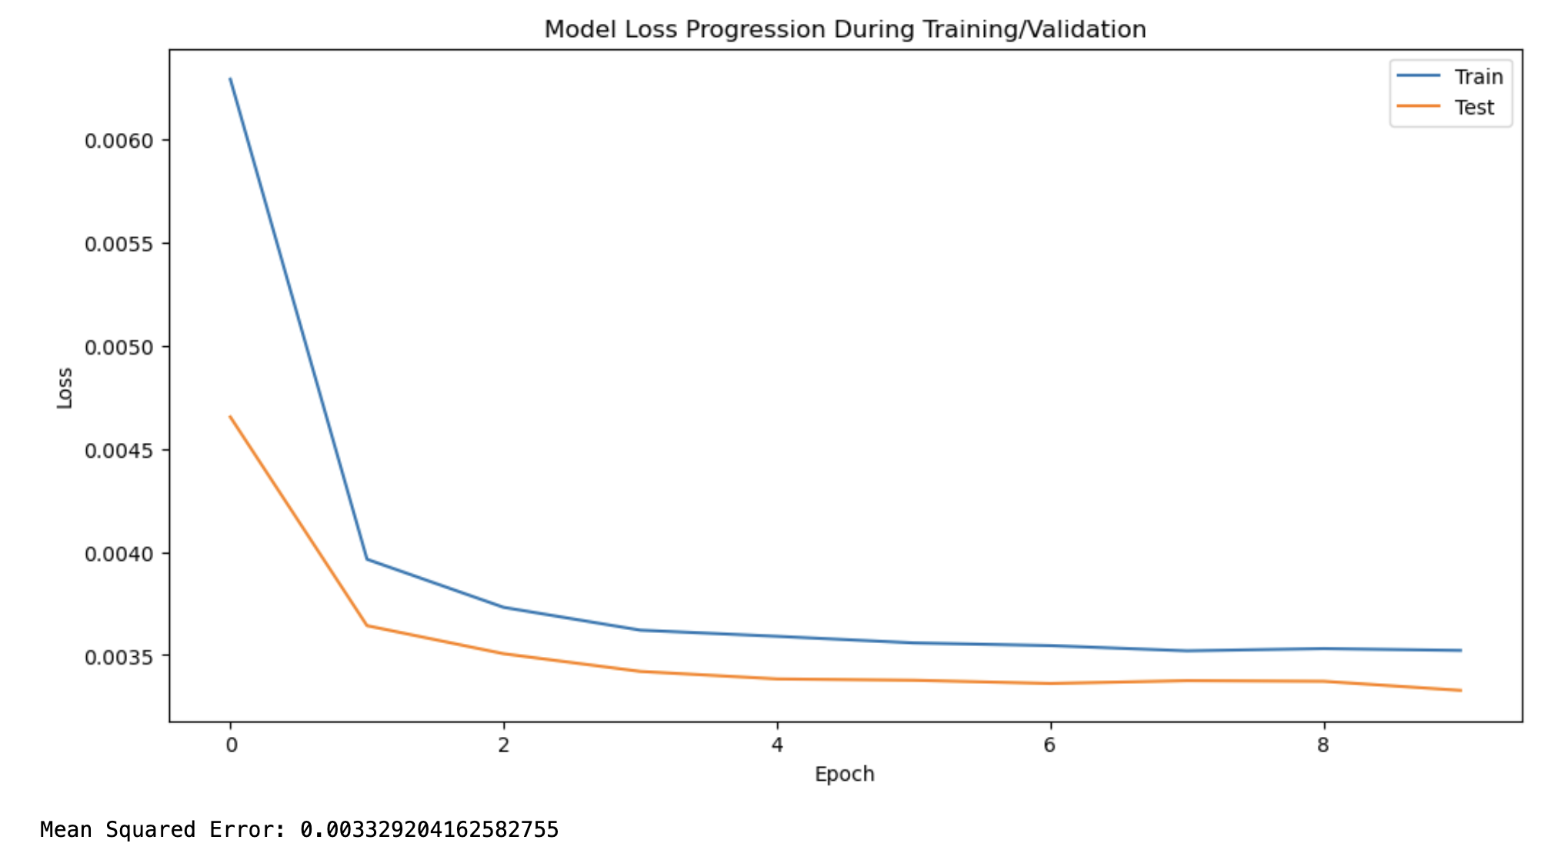
LSTM Model Results
We have randomly sampled 1000 webpages to train our model and observed the following results.

Slide 10
Thank You!

